Slide 1
Predicting realistic and precise human body models under clothing based on orthogonal-view photos
2018.05.16
Jae-Ryun Chung

Slide 2
Introduction
Two methods for developing digital human body models
  Construction method
    Body scanning – bulky and expensive
    Require tight-fit clothing
  Reconstruction method
    From image or size measurements, deform a model using technologies
    Require tight-fit clothing
Propose intelligent two-phase method based on 2 photos
  Orthogonal view
  DO NOT require tight-fit clothing

Slide 3
Related work
Reconstructive modelling methods
  One of most famous methods is SCAPE[2]
  SCAPE cannot effectively deform detailed local shape features
Zhu et al. [1]
  Customize body shape from two orthogonal-view photos
  17 key feature parts
  Require tight-fit clothing
Estimate or deform body shape under clothing in images
  Guan et al. [8] - estimate 2D human body shape and poses
  Zhou et al. [9] – reshape human bodies in images
Hasler et al. [10]
  Can only capture the average shape deformation
  CANNOT reach the accuracy of body model customization

Slide 4
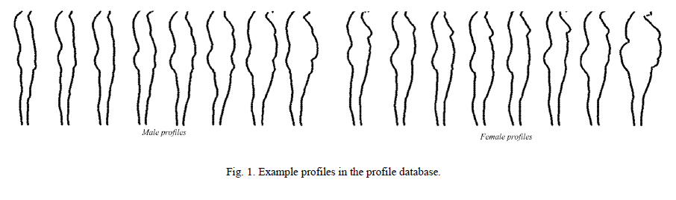
Methodology
Two-phase method to customize human body models
  First, predict 2D feature of body shape under clothing
  Then construct 3D body shape feature and customize model
2D feature prediction
  Define 2D feature as body profiles – front-view and side-view profiles
  Challenging – most part of body profile is covered by clothing
    Database of normalized body profiles - 5000+ scans of real subjects

Slide 5
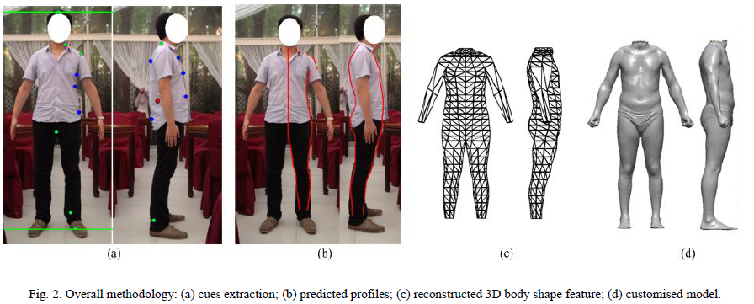
Methodology
Challenging – most part of body profile is covered by clothing
  Extract body feature cues from photos and predict complete profiles
    Due to complex situations of images, cue extraction by manually select
    Feature points are categorized into 2 types
    Reference points - Define locations of key body features – e.g.) neck, angle,..
    Boundary points
      Potential body shape
      Generally, should be defined at locations where contours not covered by clothing
      To Allow more flexibility, users can manually define even locations contours covered

Slide 6
Methodology
7-9 boundary points on 2 photos
Boundary points are normalized by reference points
Search profiles with similar features in database
  Calculate difference between boundary points and feature points at same level of profile
  Search a number of N profiles with least total differences of boundary points
  Synthesize one single profile by combining N selected profiles

Slide 7
Methodology
3D feature reconstruction
  Framework involving 30 cross-sections
    Built automatically recognizing some key cross-sections
    Interpolate extra cross-sections
  Extract local and global features from profiles
    Local features
      Widths and depths of 30 cross-sections obtained by locating relevant levels of profiles
    Global features
      Relative positions of key cross-sections
  Local features used to predict 3D shape of cross-sections
    Based on relationship model learnt between local features and cross-sectional shape
  Reconstruct 3D body shape feature using global features
  Deform template model using ct-FFD algorithm [1]

Slide 8
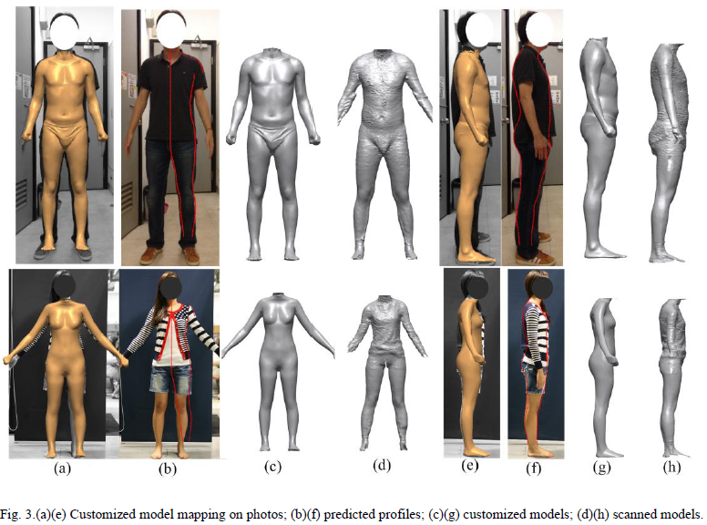
Experiment result
Loose-fit results
  6 males and 15 females with diverse body builds

Slide 9
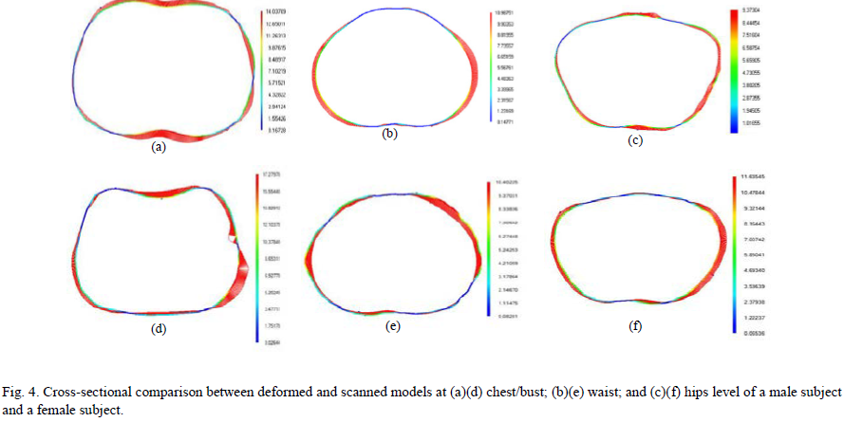
Experiment result
Loose-fit results
  6 males and 15 females with diverse body builds

Slide 10
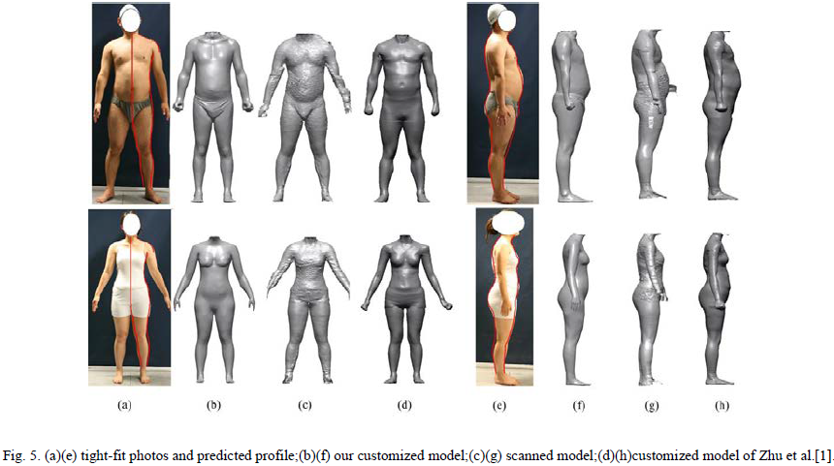
Experiment result
Tight-fit results
  6 males and 15 females with diverse body builds

